Slide 1
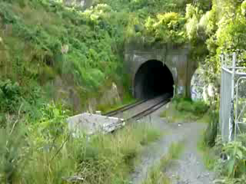
Train leaving Parnell tunnel
Towards a secure, sustainable, low emission fuel in New Zealand

Slide 2
.
Introduction Veranis
Goals:
Create comprehensive solutions for liquid energy use
Future proof liquid energy in New Zealand & Pacific
Path:
Liaise with authorities and
Assist operators of ‘diesel’ engines to improve:
Emissions - Strategic Position - Brand/Image
How:
Expert Advice and Coordinate: Design, Build and Operate

Slide 3
Introduction Veranis
Model:
Provide consultancy, project management and services (JV’s)
NOT producing or selling a fuel
.
Timing:
New Zealand emission guidelines on-road
  used imports – after 1-2010 to 1-2013 euro 4 after 1 2013 euro 5
  new imports – after 1-2010 and before 1-2011 euro 4
  ARTA contracts: Euro 3
Shipping : Marpol Annex VI entered into force on 19 May 2005
  as of October 2009 56 countries representing over 46% of the world's tonnage had become party to it.
  – NZ does not YET consider this – Australia & Pacific does!
‘Peak oil’ occurred in 2009

Slide 4
Key People
Tony Devos – R & D Director
Qualified BMW Master technician
Worked with the R&D departments of the worlds leading automotive manufactures throughout Japan, Korea and the USA.
Ian Coard – Projects & Operations Director
Oil & gas industry for most of his 32 year career
2007 retired as Chevron’s Manager – Global Downstream Projects (Houston) Involved capital stewardship of major projects focusing on the new businesses in Asia, Middle East and Latin America.
Drs. Ben Keet FRSC, Managing Director
22 years Geo & Hydro: 4000 environmental projects worldwide
Set up and managed companies in Wellington (‘88), Melbourne(‘90), Sydney (‘91), Brisbane(‘91), Perth(‘93), Arnhem & Assen (‘94 Holland), Grand-Duché de Luxembourg (‘95) and from 2003 back in New Zealand
5 years Shell International : UK, Algeria, Gabon, London
5 years Lecturing Physics & Models, University of Amsterdam
Others: Marine, Mechanical, Structural Civil and Chemical Engineers, all 20 yrs+ experience

Slide 5


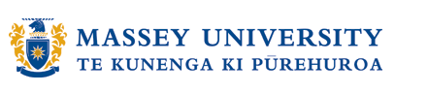
Research support
  Centre for Smart Product Wellington Polytechnic (WELTEC)
  Dyno-bay, engine testing of fuels
  Massey University, Institute of Fundamental Research
  Physical, Chemical and Electrochemical analysis
  Victoria University, School of Chemical and Physical Sciences
  Analysis of surface active nano-structures

Slide 6
HISTORY of the VERANIS Team
2008 - R & D facility established on WelTec premises
2008/10 - MOT Heavy Vehicle Productivity Project
2009/03 - Presented at the Geneva International Advanced Mobility Forum
(I.A.M.F.) – contact with other Green Diesel producers in Europe
2009/05 - ‘Static' Generator Trials at Seaview Transfer station (300KVA)
2009/08 - ’Mobile’ Equipment Trials at Wainuiomata landfill
2009/12 - 10KL/Day production capacity
2010/09 - Commencing bus project with national operator
Veranis Corporation Ltd is a NZ owned and operated Company,
with a strong desire to make New Zealand a better and cleaner place.

Slide 7
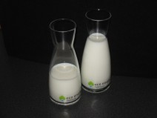
Solution to (Air) Pollution: Dilute with Water
What is emulsion fuel?
Emulsified fuels are defined as emulsions of ‘water in fuel’.
Typically made of 10-20% water
Additives are used to stabilise the fuel
* Water can be blended with other
hydrophilic fluids (alcohols, etc.)
Oil
Technology
Stable Low Emission Fuel
Water*

Slide 8
History of emulsified fuel…
Adding water to diesel dates back to the early 1900’s. There are hundreds of patents issued on water-diesel blends.
1931 Joseph Vance - liquid fuel of hydrocarbon and 40 to 60% water
1944 Sol B. Wiezer and Vaman R. Kokatnur - Up to 50% water in hydrocarbon fuels
1951 Bernard Magui and Andre Gerard - apparatus to emulsify water into fuel
1971 Eric C. Cottell - apparatus to emulsify up to 50% water into hydrocarbon fuels
1979 "Fire Resistant Diesel Fuel" Southwest Research Institute (SwRI)
1987 Gerold Kunz of Zurich, Switzerland, Assignor for Zugol AG files patent for water in fuel oil
emulsions.
1991 Rudolf W. Gunnerman filed a U, S. Patent for 20 to 80% water emulsified into hydrocarbon
fuels.
1995 Nevada certifies Advanced Fuels water in fuel emulsions as a "Clean Alternative Fuel“
1997 A-55 and Caterpillar dissolve joint venture to pursue different programmes and better
capitalise on business opportunities.
1997 Lemelson-MIT Program name Dr. Gunnerman the inventor of the week
2001 California Air Resources Board (ARB) verifies PuriNOx as Alternate diesel fuel
2002 California Air Resources Board (ARB) verifies Aquazole as Alternate diesel fuel
2002 PuriNOx receives EPA fuel registration
2003 European Emulsion Fuels Manufacturers Association (EEFMA) formed
2005 Environmental Defence Fund includes overview of diesel/water emulsions in the "Cleaner
Diesel Handbook"
2006 Federal fuel tax reductions for diesel-water fuel emulsions

Slide 9
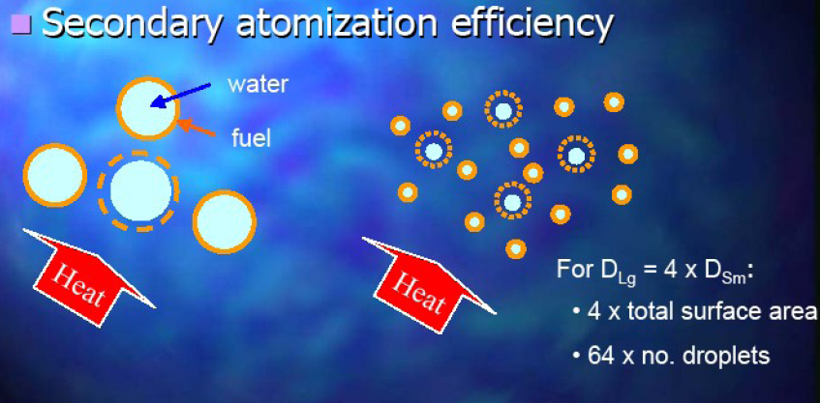
Why do emulsion fuels burn more complete?

Slide 10
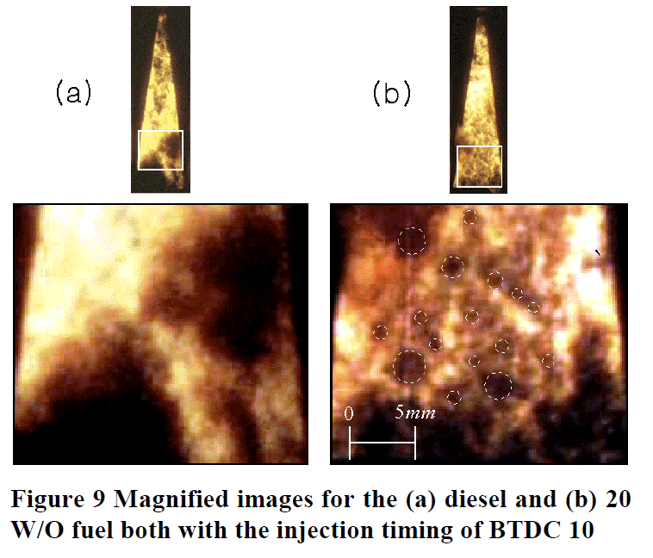
Why do emulsion fuels burn more complete?
In cylinder
high speed photography shows better mixing of fuel
and air
resulting in
more complete combustion

Slide 11
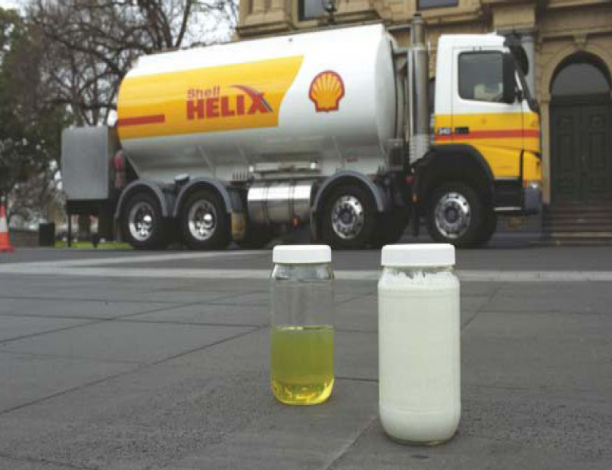
Emulsion fuels produced by Major Oil Companies
Shell: Aquadiesel
Lubrizol: PuriNOx used in
Chevron’s Proformix™
BP: Orinomulsion, Aspira
TotalFinaElf: Aquazole

Slide 12
Established use areas:
On-Road :
  Public fleets.
  Mass transit fleets.
  Private fleets.
  Garbage collection fleets.
Off-Road:
  Marine engines
  Locomotives.
  Power generation.
  Construction equipment.
Other:
  Large combined energy - heat installations
  (apartment complexes, hospitals, universities, etc).
  Industrial boilers

Slide 13

Examples of city buses, ports, shipping.
Port of Los Angeles (PuriNOx)
Port plant (cargo movers, lifters)
Verified Technologies US EPA
“Clean bus tech.”
France, Buses – TotalFinaElf
Singapore Shipping Corporation
Italy, Buses - Arriva

Slide 14
Fuel testing laboratory at Weltec
“Highest quality in the Southern Hemisphere”
– Andrew Campbell - Fuel Technology Limited, Advisor to NZ Government
Clients:
Ministry of Transport
Overseas additive testing “snake oil testing”
Solid Energy → bio-fuels division

Slide 15
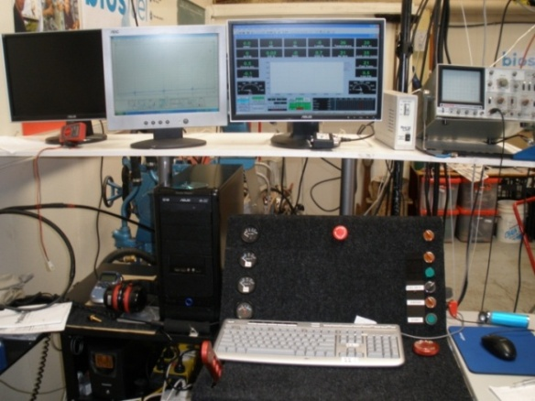
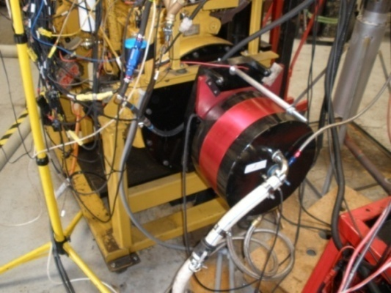
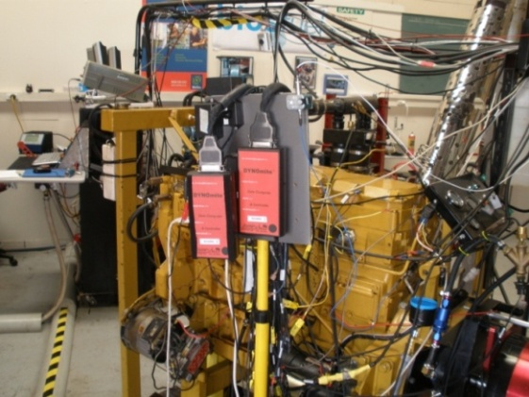
Fuel Testing Laboratory
A Lab with
Very Little Glassware
Real engines
Real Performance Results

Slide 16
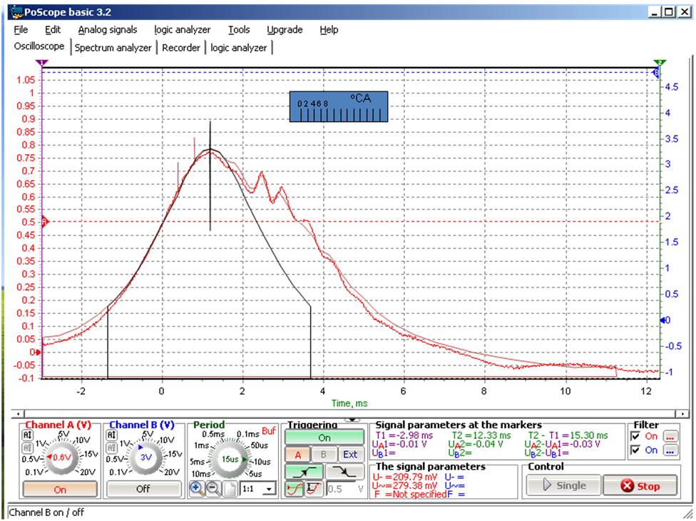
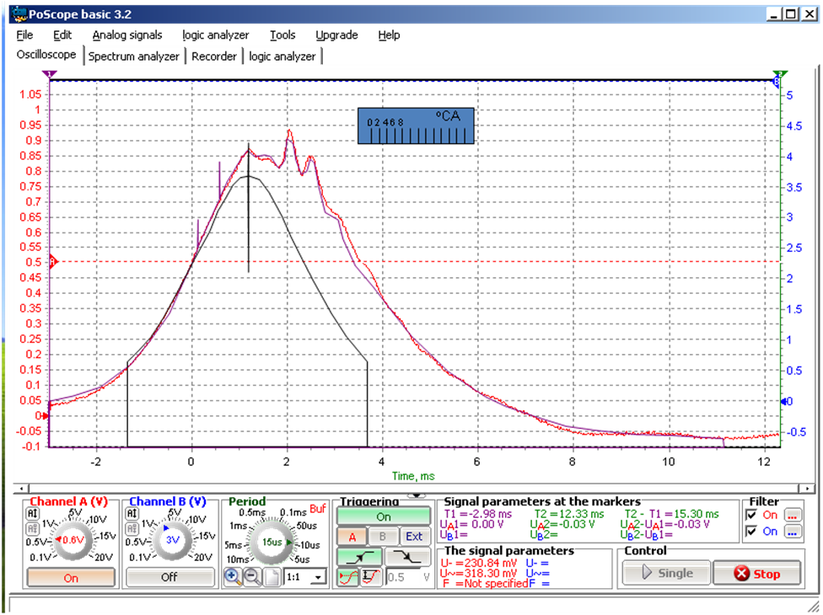
In cylinder pressure: ‘internal steam engine effect’
Cylinder pressure at 2000 RPM, 200 Nm, engine running on Diesel
Same conditions, now running on Emulsion Fuel
Note early pressure rise and
larger area under pressure curve
= more ‘work’ done

Slide 17
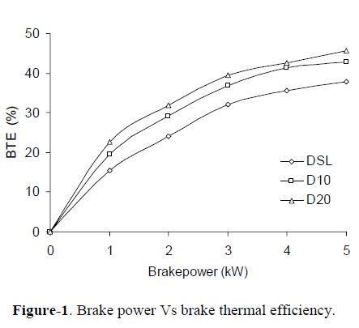
Thermal Efficiency = “work” per liter hydrocarbons:
Increased thermal efficiency
means :
More ‘work’ out of
each liter of fuel
=
Savings on fuel costs
+
Reduction in CO2 emissions
( → ETS credits)
@ 20% water Weltec lab found 4 – 8 %
Research in India: Kannan, K. et al. ARPN J. of Eng. and Appl. Sc. Vol. 4, 8 Oct 2009

Slide 18
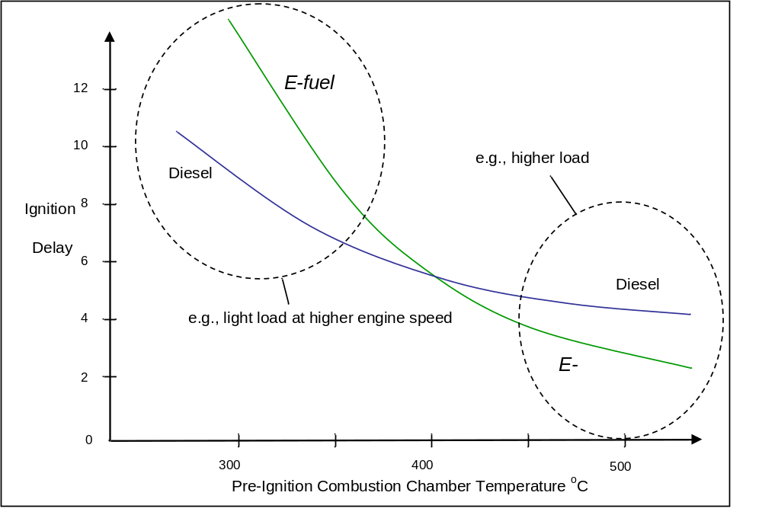
Engine Performance comparison
Green
Diesel
Green
Diesel
Green diesel emulsions are most effective in medium to high load applications

Slide 19
Emission Reductions – average for 20% water Green Diesel
Green Diesel

Slide 20
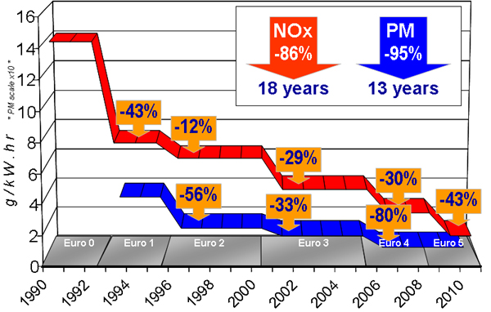
Emissions by engine type: NOx / PM
School bus age
Emission ‘shift’ by using Green Diesel

Slide 21
Emission reduction effect using emulsion fuel:
Diesel Fuel Green Diesel
PM Euro 0-1 Euro 3-4
NO_{x} Euro 0-1 Euro 3-4 (5 with cat-conv.)
Or ‘in pictures…..’

Slide 22

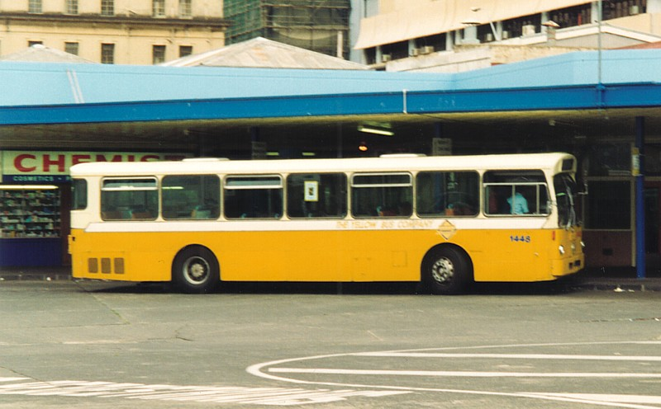
Example : Particulate Matter (PM)
=
1 x Euro 1 ‘1992’ equals:
(current school bus)
18 x Euro 4 ‘2008’

Slide 23
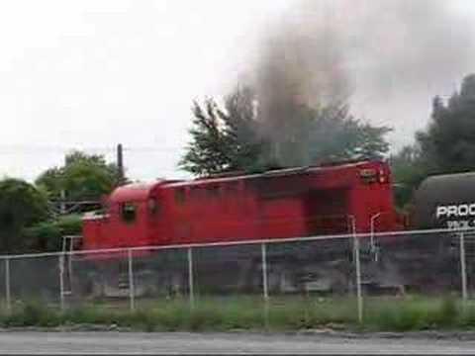
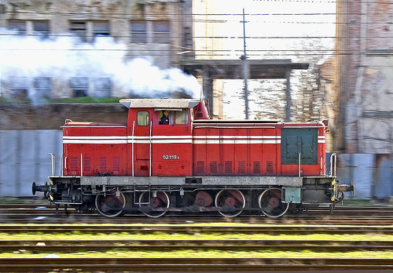
Why reduce emissions?
Example: Diesel Locomotives
Produce large amounts of pollutants from their exhausts because of:
    size,
    age and
    distance travelled
Stop – starts at stations and shunting requires many accelerations
→ PM emission is highest under these loads

Slide 24


Auckland Region: Conclusion of Air Pollution Study
~ 400 die prematurely p/a
~ 250,000 restricted activity days p/a
The old and young are most vulnerable
~ $1.3 billion per annum (!) cost
~ 60% of PM emissions is related to diesel use
Assuming ½ of diesel use will become emulsified fuel
Financial health benefit of Green Diesel: $ 400 million / year
….. Forever !

Slide 25
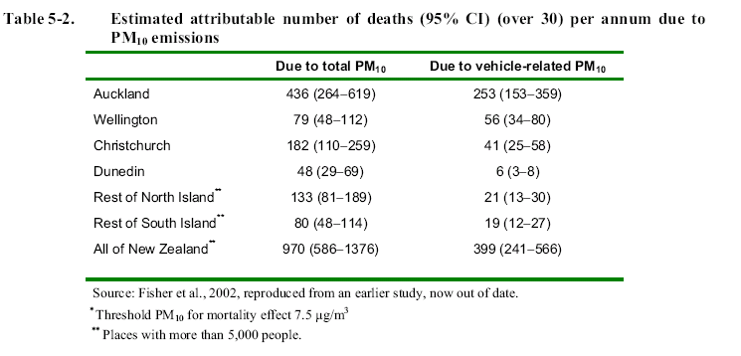
Health effects PM – Rest of NZ
71 %
Financial health benefit of Green Diesel in Wellington: $ 80 million / year

Slide 26
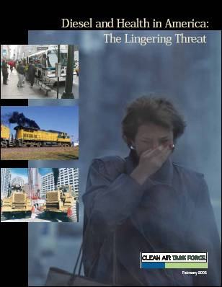
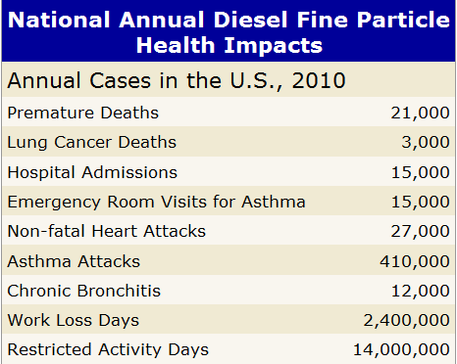
The same across the world:
Ref: www.catf.us/publications/view/83

Slide 27
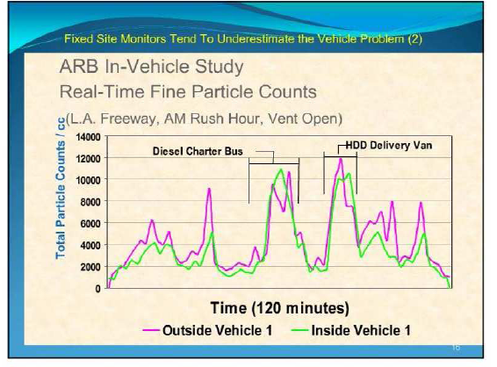
Peak more important than Average PM
Dynamic particulate profile vs.
Fixed Averaging PM Monitors
In cities peak emissions occur during peak hour

Slide 28
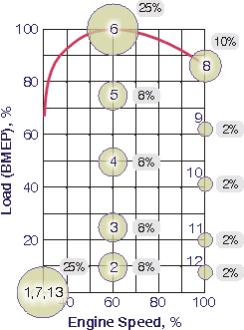
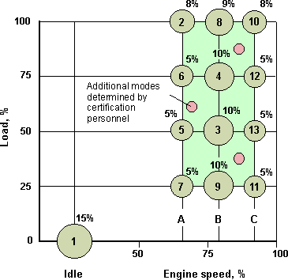
Need to standardise emission test cycles
ECE R49 Cycle: European Stationary Cycle (ESC):
x = expected cycle bus in city
x
x
Not all test cycles are the same – need to standardise → parallel project

Slide 29
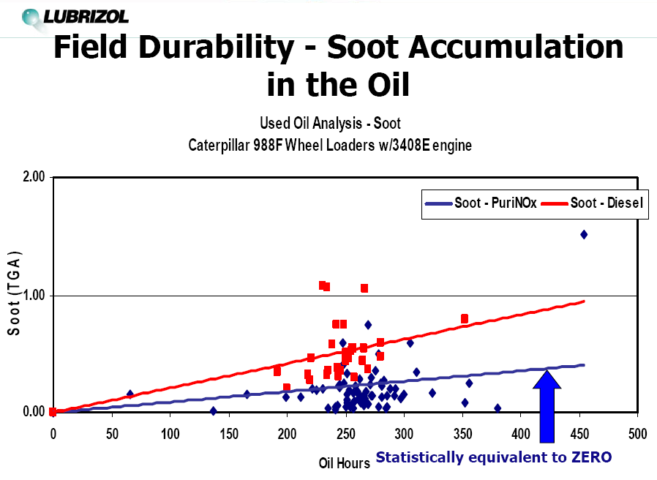
NOT only the health / environment gains!
Engine life is extended or ……………..

Slide 30
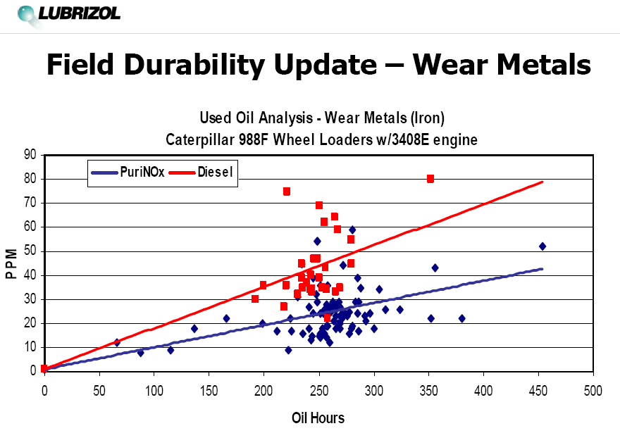
NOT only the health / environment gains!
……… maintenance cost decreased
.
of diesel engines running on Green Diesel

Slide 31
Comparison with upgrading to more modern engines :
Performance Criteria | Change fuel Green Diesel | Change engine to Euro 5,6,7
Thermal Efficiency | increase | decrease
Engine Life | increase | decrease
Maintenance | decrease | increase
Total Costs | decrease | increase

Slide 32
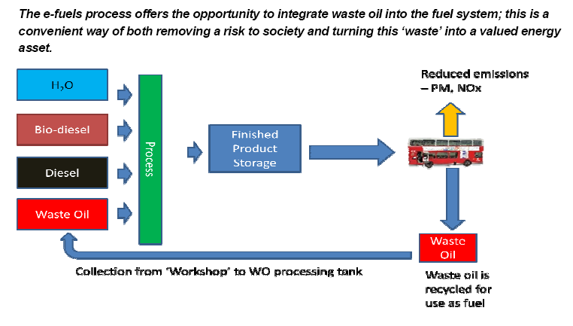
ALERT Model – building on Emulsions
Alternative Low Emission Renewable Technology Fuel for the future
Product: Green Diesel™

Slide 33
ALERT Multi-fuel system utilises ALL feedstocks
Blend in at various rates (as available)
Original fuel spec. less important in Emulsified Green Diesel
Emulsions can modify viscosity
Emulsified bio-fuels have lower NOx emissions than fossil diesel
Therefore:
Emulsion fuels create strong stimulus for Bio-fuels
Leads to decentralisation of fuel supply (less transport)
Final aim: NZ & Pacific fuel supply : independent from imports,
secure from natural disasters
sustainable and
environmentally sound

Slide 34
Diesel Import Independence – A DREAM for NZ ?
Example: Total diesel use in NZ: 2.8 BL/yr (2007)
Acreage required to produce Bio-Diesel :
L/Hectare
Ha reqd. 3 BL/yr
Algae
3000
957,696
Dairy model
Palm oil
4752
604,606
Pacific
oil sheiks
Coconut
2151
1,335,699
Rapeseed / Canola
954
3,011,624
small %
Current Pinus Radiata
1,708,282
Current pasture
8,086,160
Current tossock grazing
2,900,463
Current grain / food crops
367,404
Note volume: Used Lube Oil (ULO) available in NZ 0.03 – 0.06 BL/yr

Slide 35
ALERT Model – Multi Feedstock Fuels
Alternative Low Emission Renewable Technology Fuel for the future
Coconut
Palm
Tallow
Soy
Canola
Sewage
Algae
Wood
i.e. not “Which”
but
“ALL”
ULO use 0.5 – 2 %

Slide 36
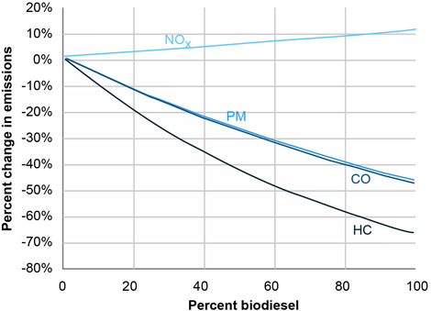
Up to 30% NOx reduction makes Bio fuels acceptable
Green diesel bio-emulsion-fuel will provide finishing touch to bio-diesel
Blue lines are from US EPA study (2009)
Red line is NOx
reduction after emulsification
A further 50% reduction of PM is expected – to be confirmed

Slide 37
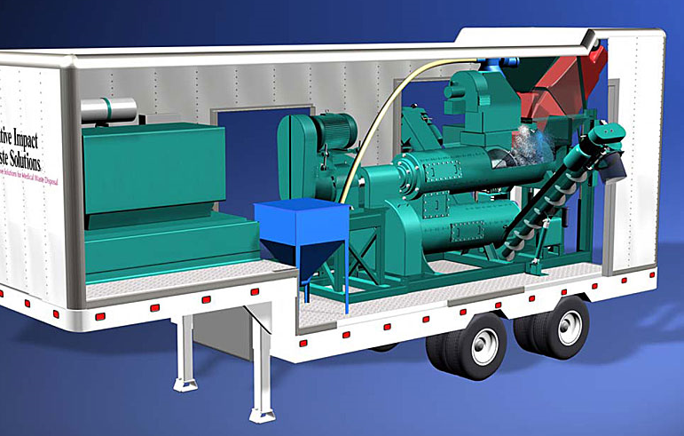
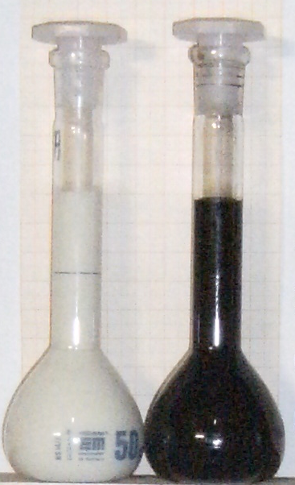

ALERT Green diesel Model in practice:
On-site blending and emulsification
Use multiple feedstocks
Mobile units
30 – 100.000 liter/day
Build to oil industry standards
Assure quality and control quality (QA/QC)

Slide 38

Emulsion fuel → an unmovable rule for NZ’s future
So despite the ‘engine race’ from
Euro 4 → 5 → 6, etc by automotive industry
Changing course to Green Diesel
will become an ‘Unmovable Rule’

Slide 39

Out of Jail card….
Switch back to Diesel is possible
at any time……
no engine
modifications

Slide 40
Regional / National Benefits Green Diesel
- Political / Economical
Improved health and associated costs ($ 400 m / yr)
Reduced fuel import dependence
Improved fuel security
Improved fleet efficiency – extent useful machine life
Reduction of environmental risks
Create employment opportunities
and most importantly………….

Slide 41

Regional / National Benefits
From a visitors and tourism perspective:
Support 100 % Pure New Zealand brand.
Support Green Image
Reduce inner city emission levels
(busses, trains and ferries)
Turn a negative (waste / emissions) into a positive
Support a strong bio-fuel industry

Slide 42
In Conclusion:
Achieving Euro 3 - 5 standard in ALL Public Transport will take……
15+ years by changing engines / bus / loco / ferry
Achieving Euro 3 - 5 standard using Green Diesel technology
this can be achieved for All Transport in….
……. 1- 2 years !!
@ 500 bus replacements operator saves $100 million by capital deferment
NZ Health savings @ 50% of engines on Green Diesel = $ 400 m !
“a no brainer”

Slide 43

The proof is in the pudding:
ALERT - Green Diesel used in Wellington region- Wainuiomata Landfill
Note ALERT fuel used : 50% used lube oil (ULO), 30% diesel, 19 % water, 1% surfactant

Slide 44
For the technical minded: Emissions (Gaseous)
Independent emission testing by Sinclair Knight Merz Ltd
(report available on request)
Sampling Run |  | O2 (%)¹ | CO (ppmv)² | CO2 (%)¹ | NO (ppmv)² | NO2 (ppmv)² | NOx (ppmv)²
Green Diesel | Average | 15.2 | 217 | 3.2 | 123 | 0.1 | 123
 | Maximum | 16.9 | 367 | 4.4 | 154 | 0.5 | 154
 | Minimum | 13.4 | 150 | 2.1 | 86 | 0.0 | 86.0
Diesel Fuel | Average | 9.3 | 2,079 | 10.6 | 240 | 4.2 | 244
 | Maximum | 11.1 | 2,272 | 11.1 | 287 | 5.5 | 289
 | Minimum | 7.5 | 1,732 | 8.9 | 198 | 1.4 | 202
High % ULO emulsion blend used at Wainui tip

Slide 45
For the technical minded: Emissions (Aldehydes)
Independent emission testing by Sinclair Knight Merz Ltd
 | Emulsion Green Diesel | Diesel Fuel | Reduction using ALERT Green Diesel
Analytes | Emission Rate (g/hr) | Emission Rate (g/hr)
Formaldehyde | 2.68 | 42.6 | 93 %
Acetaldehyde | 1.59 | 12.1 | 86 %
Propionaldehyde | 0.113 | 0.780 | 85 %
Acrolein | 0.328 | 7.98 | 95 %
High % ULO emulsion blend used at Wainui tip

Slide 46
FAQ’s
Do you sell fuel ? | NO, only a processing service
Using Green Diesel are engines changes needed to meet the Euro 3 – 4 standard? | NO, permanent modifications are not required.
Is Green Diesel more expensive ? | Per liter, yes. In the big picture NO, health cost reductions, longer engine life, reduced maintenance and deferred capital expenditure offers a high value solution for all stakeholders.

Slide 47
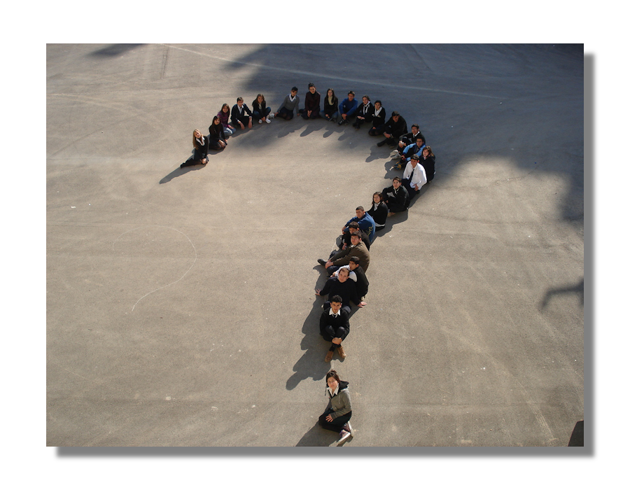
Questions Please........
Veranis Team thanks you for your attention.
Soon open: www.Veranis.co.nz and www.GreenDiesel.co.nz

Slide 48
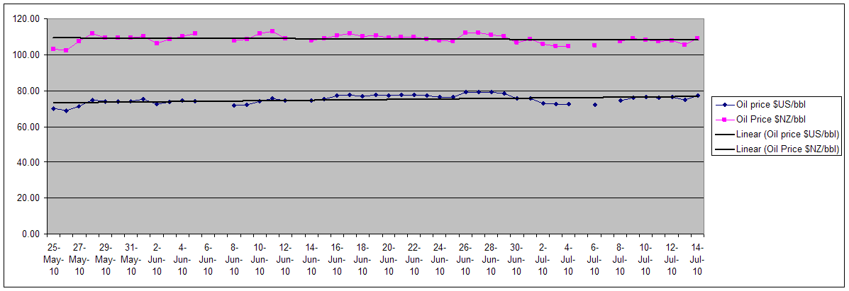
Financial reasons to look at diesel replacement
1. In NZ variations in oil price is countered by currency fluctuation.
As soon as this mechanism is released, NZ will experience the real price rise.
2. Ensuring ALL resources can be used in a multi-feed stock model.
Don’t waste ‘waste oil’ (ULO)

Slide 49
Fuel from Waste: A solution for Lube Oil in New Zealand
More advantages of emulsified fuels
NZ Imports 60 million litres lube oil annually.
Only 50% of this oil is currently recovered as used lube oil (ULO).
ULO can be incorporated into the fuel supply chain
ULO combusts in a diesel engine exactly the same as diesel.
WHEN emulsified: Same performance, same emissions
Solution to waste oil → blend into ALERT Green Diesels
(can be 50% however in practice around 1 %)

Slide 50
Waste Oil – towards a new system
Current recovery model requires improvement
  Transported distance
  Education of producers
    Waste education programmes (Env. Centres)
    Containers labelled informing of safe drop off locations
  Recovery points
    Safer collection systems
  Audited system (chase the missing volumes!)

Slide 51
ALERT Waste Oil Solution – Use where produced :
Small Producers
(home mechanics etc)
Medium Producers
(garages etc)
Large Producers
(Bus Depots, Mines etc)
Safe collection &
storage at Tip /
Transfer / Bus depot
Truck collection
Central Storage facility
Onsite collection & storage
Alert Green Diesels Mobile Blend Solution
Fuel use:
Tip plant/Bus etc
Alert Green Diesels Central Blend Facility
Fuel use:
(Shipping, Rail, Civil)
Alert Green Diesels Mobile Blend Solution
Fuel use:
Buses/mining plant etc
Objectives:
Waste Oil collected safely/reduced transport distance/
plastic recycled/filters disposed safely

Slide 52
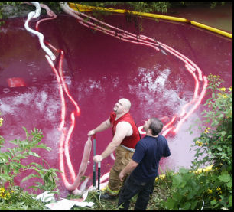
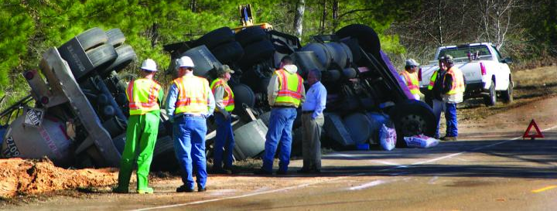
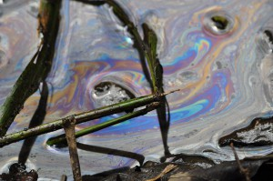
Waste Oil Threat
1 part per million makes water unsafe to drink
35 ppm creates visible oil slick that damages aquatic life – fish and shellfish
50 ppm can foul a wastewater treatment plant
At 1 ppm, one tankerload (30 m³)
can contaminate
30.000.000.000 liters of drinking water
http://www.nj.gov/dep/watershedmgt/cleanwaterbook/waterbook_chp10.htm

Slide 53
Bus Project “Ahead of the Game”
Objective:
Convert all bus depots of one major operator in
New Zealand - to supply low emission fuel
6 stage approach
Target date → Start of Rugby World Cup 2011.
Stakeholders:
GWRC, WCC, LHCC, ARTA, Operator, Veranis

Slide 54
Bus Project “Ahead of the Game”
Stages
1 – project initiation, form stakeholder group, secure funding
2 – proof of concept, technology, quality
3 – run 10 school busses on emulsion fuel, prove logistics
4 – convert 1 depot to supply emulsion fuel
5 – convert all depots in Greater Wellington Region
6 – convert all depots in rest of NZ (Auckland)

Slide 55
Decision ‘GO’ or ‘STOP’ at each stage:
Example: Stage 2
Bus Project
Technology
Quality
Logistics
Goal:
Proof of concept
Achieved
Not Achieved
Go to stage 2
Stop

Slide 56
Stage 2: Proof of concept (lab based) 8 – 10 / 2010
Technology:
  engine testing in WelTec Lab
  simulate real life load (school routes)
  determine emission profile
  check by emission testing on-road
  Rerun step 3 & 4 on ALERT fuel
Quality:
‘Achieved Could be’ …..
  Euro 3 emission level achieved
  Fuel stable, works always
  Regionally economically viable
Customer to decide… (RC’s)

Slide 57
Stage 3/4: Proof of concept (Road testing) to 12/ ’10
3: ‘School bus pilot – Approx. 10 busses’
Technical – Quality – Logistics & Financial
  Determine emission reductions
  (on road conditions)
  Calculate financial (health) effects
  Calculate financial gain by deferring capital expenditure
4: “In-Depot” Logistics:
at one depot….→ All busses
Adjust fueling system to allow emulsification unit
Deliver ALERT fuel on time – every time
and of consistent QUALITY

Slide 58


Stage 5 and 6: Regional and National Roll-out 8/ ‘10
5: Regional Roll-out
“Ensuring that all buses that are currently running on diesel
within the Greater Wellington Region are running on Emulsion Fuel
6: National Roll-out (438 days to complete)
“Ensuring that all buses that are currently running on diesel
within the Greater Auckland Region are running on Emulsion Fuel
by the start of the 2011 Rugby World Cup”
Completion of Project
“Ahead of the Game”
09-2011

